Slide 1
MSU Solar Physics NSF REU Final Presentation
Student: Chace Carlson, Aerospace Engineering Senior at ERAU
Mentor: Dr. Dave Klumpar, Research Professor of Physics and Director, SSEL
Department: Space Science and Engineering Laboratory (SSEL)

Slide 2
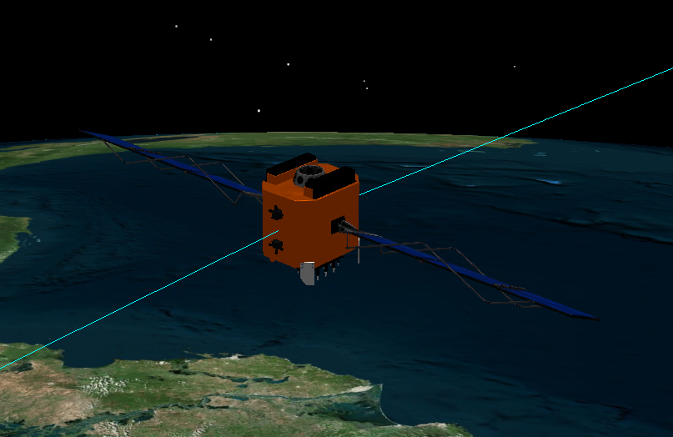
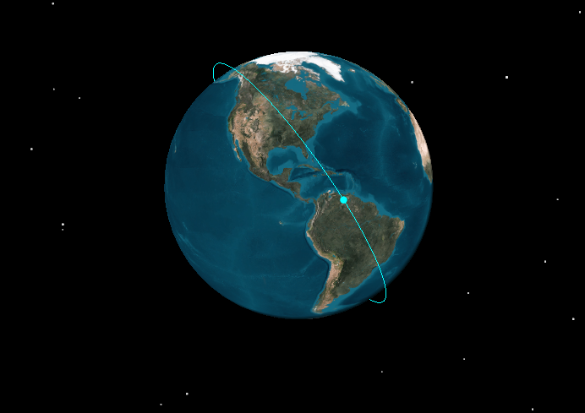
Specialty: Guidance, Navigation, and Control (GNC)
Attitude Determination and Control Systems (ADACS)
Trajectory Planning and Propagation Calculations

Slide 3
Last Time:
IT-SPINS
Test Board & ADACS Board
Ground Station & Dynamic Simulator
ADACS Telemetry Programming
MLTAN to RAAN
Sun Vector Calculations
Sun Angle Calculations
Mission Concept 1
Orbital Analysis
Mission Concept 2
Orbital Analysis

Slide 4
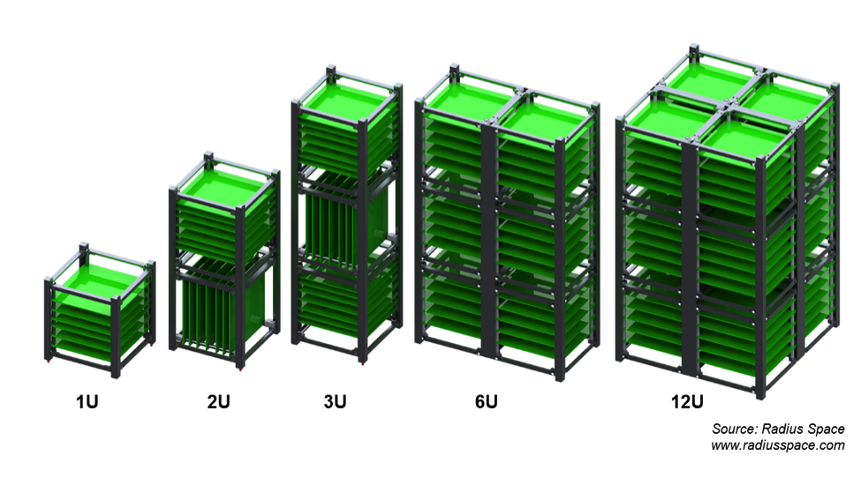
1U vs 3U vs 6U

Slide 5
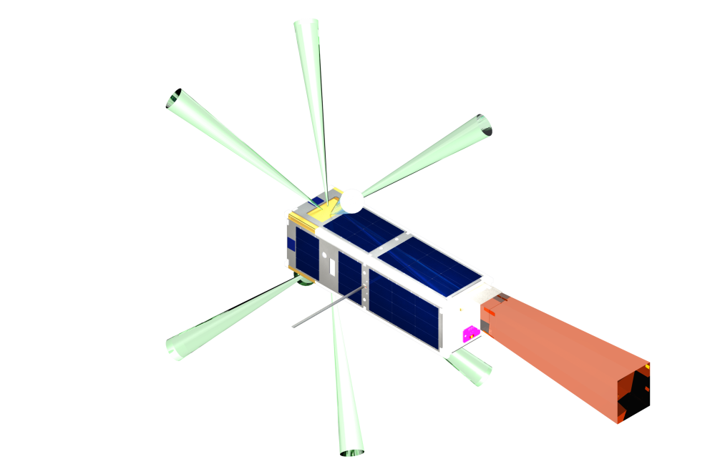
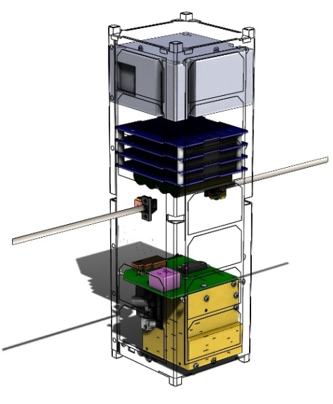
Mission: IT-SPINS
Ionospheric-Thermospheric Scanning Photometer for Ion-Neutral Studies
Size: 3U CubeSat
Launch: October 2017, NASA Educational Launch of Nanosatellites (ELaNA)
Payload: Stanford Research Institute International Cubesat Tiny Ionospheric Photometer (CTIP)
Mission: To provide the first 2D tomographic imaging from a 3U research CubeSat. Also, it is MSU’s first CubeSat with an active ADACS system.
Orbit: Circular, 450 km altitude, 92° Inclination
Attitude: Spinning @ 2 rpm (about antenna axis)
Phase: Hardware Development
Delivery date: May 15, 2017

Slide 6
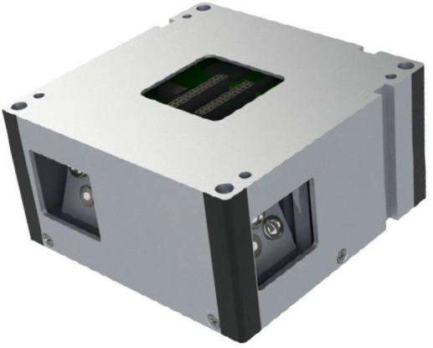
IT-SPINS: MAI-400
Maryland Aerospace Inc.
CubeSat ADACS Systems
Custom MAI-400
Size: ½ U
3 reaction wheels
3 axis magnetometer
2 IR EHS
3 electromagnets
ADACS Computer
Custom ACS Mode
Photos courtesy of Maryland Aerospace Inc.

Slide 7
MAI-400: ADACS Telemetry Programming
Work w/software engineers
Integrate with SFC
Problem solving! (Weird integers)
Example ADACS Telemetry:
90 EB 11 B6 25 36 42 00 03 00 00 00 00 00 5C 01 00 00 F0 00 10 00 00 00 00 00 00 F0 0F 00 7C F8 80 00 ....

Slide 8
MAI-400: Visualization
Dynamic Sim > MATLAB > STK
STK = Systems Tool Kit

Slide 9
Proposal 1
Size: 6U CubeSat
Launch: Unknown, Early 2018
Mission: Optical signatures of atmospheric gravity waves, traveling atmospheric disturbances, and traveling ionospheric disturbances against the limb far ultraviolet background
Orbit: r_{p}= 400-600 km, r_{a} = 500-600 km, i > 65°
Attitude: 2 modes: spinning @ 2 rpm or nadir pointing
Phase: Proposal Sent to NASA in July

Slide 10
Mission Concept 1: Power Budget
Calculated average power generated every month, over the course of 1 day
6 Scenarios:
Worst Orbit Spinning @ 2 rpm
Average Orbit Spinning @ 2 rpm
Best Orbit Spinning @ 2 rpm
Worst Orbit Nadir Pointing
Average Orbit Nadir Pointing
Best Orbit Nadir Pointing

Slide 11
Proposal 2
Size: 6U CubeSat
Launch: Unknown, Summer 2019
Mission: In-situ measurements of the O⁺ and H⁺ Temperatures and the electron temperature in the same volume
Orbit: r_{p}= 400-500 km, r_{a} > 800 km, i > 50°
Attitude: 2U facing Nadir, 3U facing Nadir
Phase: Proposal Sent to NASA in July

Slide 12
Mission Concept 2: Power Budget
Calculated average power generated every month, over the course of 1 day
6 Scenarios:
Worst Orbit 2U Nadir Facing
Average Orbit 2U Nadir Facing
Best Orbit 2U Nadir Facing
Worst Orbit 3U Nadir Facing
Average Orbit 3U Nadir Facing
Best Orbit 3U Nadir Facing

Slide 13
Solar Power Budget Tutorial
In STK:
Input orbit (worst orbit if mission concept)
Input attitude
Propagate over 1 year, starting on launch date
Generate X,Y, and Z Body Axes Sun Vectors, 1 day per month
Interval list written via MATLAB
Output vectors as .csv file

Slide 14
Solar Power Budget Tutorial (cont’d)
In MATLAB:
Run Sun_Vector_Call_Script.m
Runs Sun_Vector_Funtion.m
Outputs 12 Excel files, calculating power generated by +X, +Y, +Z, -X, -Y, -Z
Run Summary_Call_Script.m
Runs Summary_Script.m
Summarizes all Excel files into 1 compact Excel worksheet

Slide 15
Solar Power Budget Tutorial (cont’d)
Excel Output for Worst Case Nadir Pointing:
Rinse and Repeat for each scenario (for mission concepts)

Slide 16
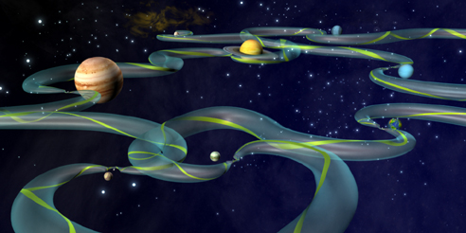
Astrodynamics Lectures

Slide 17
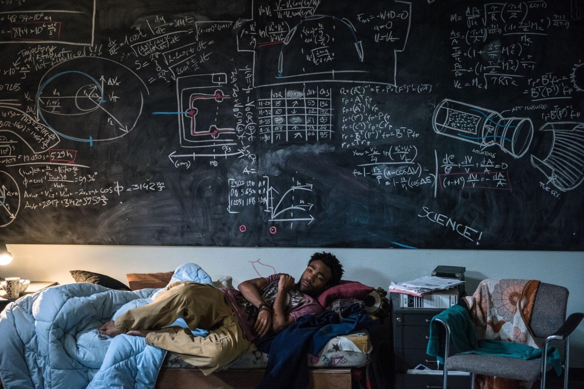
Conclusion
IT-SPINS
MAI-400
Ground Station & Dynamic Simulator
ADACS Telemetry Programming
Mission Concept 1
Power Budget
Mission Concept 2
Power Budget
Solar Power Budget Tutorial
Astrodynamics Lectures

Slide 18
Questions? https://www.youtube.com/watch?v=lQXHaXujkUY

